Slide 1
Process Scheduling Module 4
Operating Systems
Nadia Qureshi

Slide 3
Chapter Outline
Scheduler
Scheduling algorithm
Objectives of Scheduling
Criteria for scheduling
CPU-bound vs I/O-bound processes
Types of Scheduling
Process scheduling queues
FCFS
SJF
Priority
Round Robin
Multilevel feedback queues scheduling
BSD Unix scheduling
Multiple processor scheduling

Slide 4
Scheduling
Scheduler
The scheduler is part of the operating system, concerned with which process to run next if multiple run-able processes are in ready queue
Scheduler is concerned with deciding on policy, not providing a mechanism
It is important because it can have a big effect on resource utilization and overall performance of the system
Scheduling Algorithm
In a multiprogramming computer several processes will compete for use of the processor
At any time only one process will be running while other will wait for process to be free
Scheduling algorithm is logic that determines the order in which processes should run when multiple processes are there
The aim of process scheduling is to achieve objectives such as maximum CPU utilization and to improve its performance

Slide 5
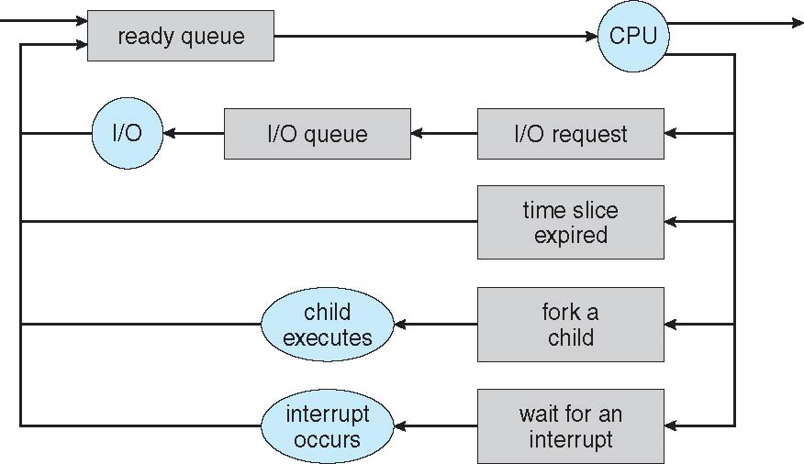
Process Scheduling

Slide 6
Process Scheduling
Execution time of CPU
Maximum CPU utilization obtained with multiprogramming
CPU–I/O Burst Cycle – Process execution consists of a cycle of CPU execution and I/O wait
CPU burst followed by I/O burst
CPU burst distribution is of main concern

Slide 7
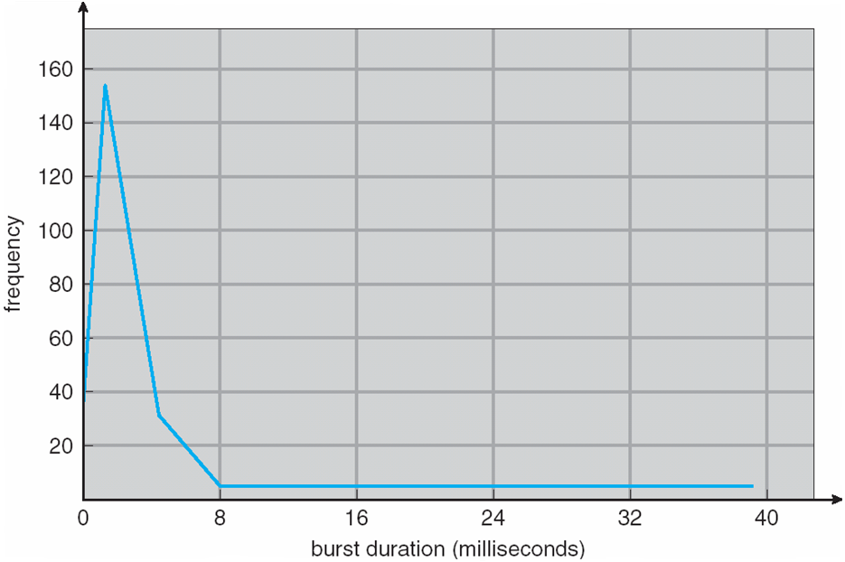
Histogram of CPU-burst Times

Slide 8
CPU Scheduler
Short-term scheduler selects from among the processes in ready queue, and allocates the CPU to one of them
Queue may be ordered in various ways
CPU scheduling decisions may take place when a process:
Switches from running to waiting state
Switches from running to ready state
Switches from waiting to ready
Terminates
Scheduling under 1 and 4 is non-preemptive
All other scheduling is preemptive
Consider access to shared data
Consider preemption while in kernel mode
Consider interrupts occurring during crucial OS activities

Slide 9
Dispatcher
Dispatcher module gives control of the CPU to the process selected by the short-term scheduler; this involves:
switching context
switching to user mode
jumping to the proper location in the user program to restart that program
Dispatch latency
time it takes for the dispatcher to stop one process and start another running

Slide 10
Scheduling Performance
CPU utilization
keep the CPU as busy as possible
Throughput
# of processes that complete their execution per time unit
Turnaround time
amount of time to execute a particular process
Waiting time
amount of time a process has been waiting in the ready queue
Response time
amount of time it takes from when a request was submitted until the first response is produced, not output (for time-sharing environment)

Slide 11
Scheduling Algorithm Objectives
Max CPU utilization
Max throughput
Min turnaround time
Min waiting time
Min response time

Slide 12
Criteria for Scheduling
Priority
Priority assigned to that process or job
Class
Class of job, i.e. batch or on-line or real-time
Resource requirements
E.g. expected run time, memory required, etc
I/O or CPU bound
i.e. whether job is I/O bound or CPU bound
Resources used to date
i.e. the amount of processor time already consumed
Waiting time to date
i.e. the amount of time spent waiting for service so far

Slide 13
Scheduling Philosophies
Preemptive
The system may preempt the CPU from a process at any time;
Prevents any one process from using the CPU for too long
Can lead to race condition (require synchronization techniques)
Non-preemptive
Each process voluntarily gives up the CPU
It is;
Simple
Easy to implement
Not suitable for multi-user systems
If the running process become blocked next process can be scheduled

Slide 14
Process Scheduling Queues
Job queue
Set of all the processes in the system
It also includes the processes from the queues given below
Ready queue
Set of all the processes residing in main memory (ready or waiting)
Device queue
Set of processes waiting for an I/O devices

Slide 15
Levels of Scheduling
Scheduling can be exercised at three levels
High-level scheduling (Long-term scheduler)
Allow limited number of processes in the ready queue to compete
It disallows processes beyond a certain limit for batch processes first and in the end also the interactive processes
Invoke less frequently
May be slow
Medium-level scheduling (Medium-term scheduler)
It is concerned with decision to temporarily remove a process from the system (to reduce system load)
To reintroduce a process or swapping in
What if there is room in memory and both a new process as well as swapped out process want to be loaded
In this case, medium level scheduler has to work in close conjunction with high level scheduler

Slide 16
Levels of Scheduling
Low level-scheduling (Short-term scheduler)
Handles the decisions of which process is to be assigned to the processor (dispatcher)
Invoke very frequently
Must execute fast
Its scheduling could be preemptive or non-preemptive
Dispatch latency should be minimum
Dispatch latency is the time it takes for the dispatcher to stop one process and start another running
Example:
Assume a process runs for 90ms and scheduler run for 10ms
Overheads = 10/(90+10) = 10%
Any OS may use one or all of these levels, depending upon the desired
These levels have to interact amongst themselves quite closely to ensure that the computing resources are managed optimally
The exact algorithms for these and interaction between them are quite complex

Slide 17
Scheduling Algorithms

Slide 18
First Come First Serve Scheduling
The FCFS simply assign the processor to the process which is first in ready queue
When the processor is free, the next process at the head of the ready queue will be selected
Consider the following set of three processes that arrive at time ‘0’
Process ID Priority Burst Time Arrival Time
P1 2 30 ms 1
P2 3 6 ms 2
P3 1 4 ms 3
The waiting time for each process is P1=0, P2=30, P3=36
The average waiting time is (0+30+36)/3 = 22ms
The average waiting time of FCFS may vary substantially if the process’s CPU burst time vary greatly
P₁
P₂
P₃
0
30
36
40

Slide 19
First Come First Serve Scheduling
Salient points of FCFS
It is the simplest scheduling algorithm
Also know as the first in first out (FIFO)
FCFS is non-preemptive
It performs much better for long processes than short processes
It tend to favor CPU-bond processes over I/O bound
It is not suitable for time sharing system
FCFS is rarely used on its own but is effective if combined with other scheme

Slide 20
Shortest Job First Scheduling
This algorithm associates with shortest job first
When the CPU is available, it is assigned to the process that has smallest CPU burst time
If two processes have same CPU-burst then FCFS scheduling is used along with this to break the tie
Moving a short process before a long one
Decrease the waiting time of short process
Increase the waiting time of long process
Consequently, the average time decreases
This will result in a smaller number of PCB’s in the ready or blocked queues
The search time will be smaller, thus improving the response time
The number of satisfied user will increase
A long job in the queue may delayed indefinitely by a succession of smaller jobs arriving in ready queue
This can be avoided by setting higher external priority to those important jobs
The OS at any time can calculates a resultant priority based on both
Also known as shortest job next

Slide 21
Shortest Job First Scheduling
Salient Points of SJF
SJF may be preemptive or non-preemptive
It will preempt the currently executing process if its remaining time is greater than that of a newly arrived process
This scheme is known as shortest remaining time first
SJF is optimal in sense that it yields the smallest average waiting time
In general, it is difficult to predict the CPU time requirement for a process
SJF is optimal for batch jobs for which the run times are known in advance
SJF reduces average waiting time over FCFS

Slide 22
Shortest Job First Scheduling - Non-Preemptive SJF Scheduling
Process Arrival Time Burst Time
P₁ 0.0 7
P₂ 2.0 4
P₃ 4.0 1
P₄ 5.0 4
SJF (non-preemptive)
Average waiting time = (0 + 6 + 3 + 7)/4 = 4
P₁
P₃
P₂
P₄
0
3
7
8
12
16

Slide 23
Shortest Job First Scheduling - Preemptive SJF Scheduling
Process Arrival Time Burst Time
P₁ 0.0 7
P₂ 2.0 4
P₃ 4.0 1
P₄ 5.0 4
SJF (preemptive)
Average waiting time = (9 + 1 + 0 +2)/4 = 3
P₁
P₂
P₃
P₂
P₄
P₁
0
2
4
5
7
11
16

Slide 24
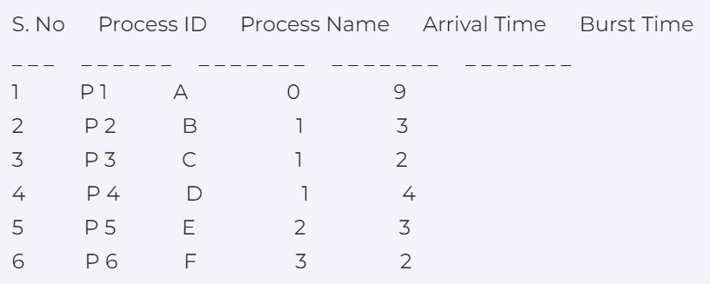
Practice Problem : Apply FCFS and SJF (preemptive) Turn Around Time = Completion Time - Arrival Time Waiting Time = Turn Around Time - Burst Time

Slide 25

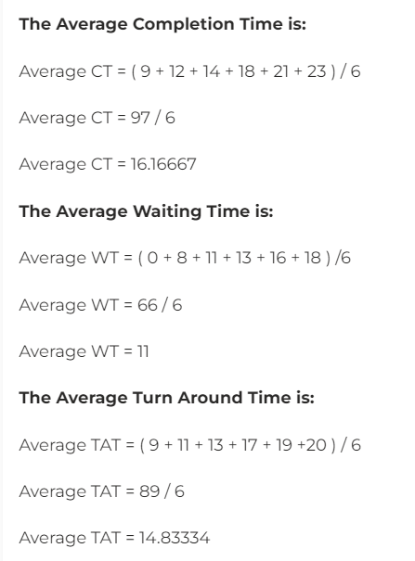
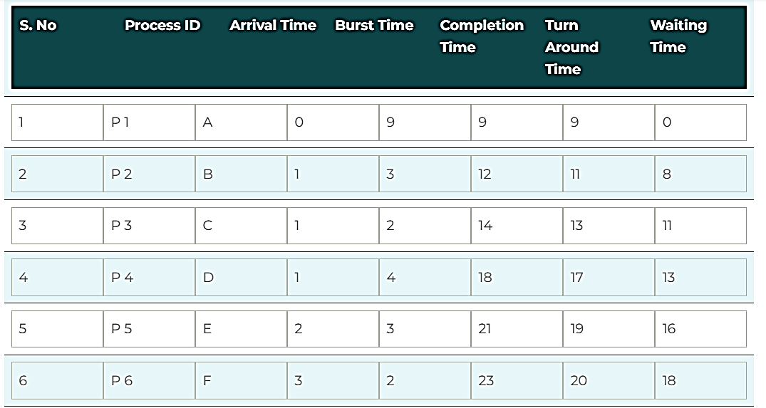
Solution: non – preemptive

Slide 26
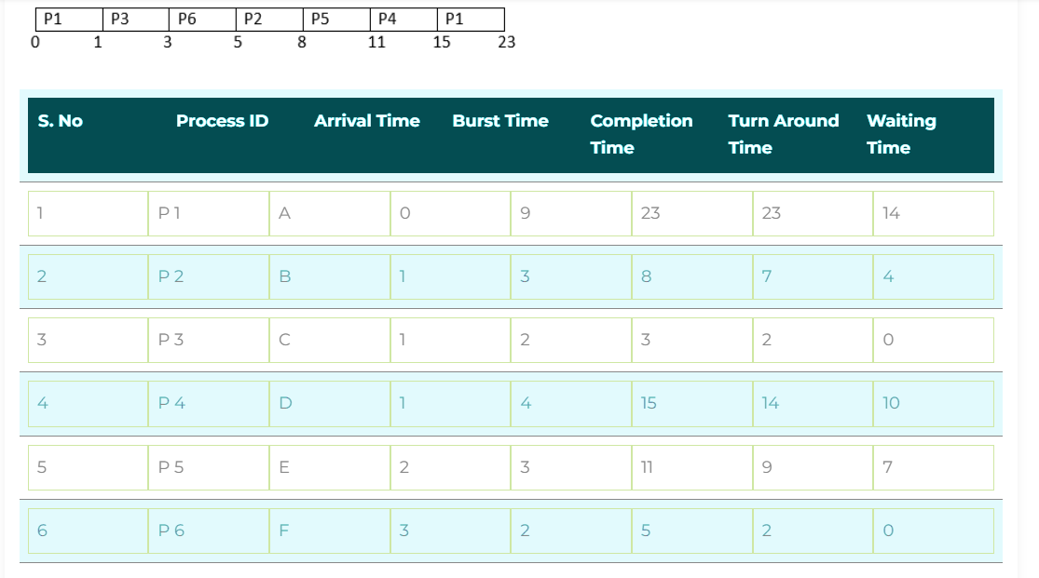
Solution: SJF - preemptive solution

